Slide 1
SQL: Schema Definition, Basic Constraints, and Queries

Slide 2
SQL Introduction
SQL stands for Structured Query Language
Standard language for querying and manipulating data
Data Definition Language (DDL)
Create/alter/delete tables and their attributes
Data Manipulation Language (DML)
Query one or more tables
Insert/delete/modify tuples in tables
Many standards out there: ANSI SQL, SQL92 (a.k.a. SQL2), SQL99 (a.k.a. SQL3), …

Slide 3
Tables in SQL
Table name
Attribute names
Department
DName | Dnumber | MgrSsn | Mgrstartdate
Gizmo | 19 | 324521 | 1992-08-11
Powergizmo | 29 | 624545 | 1982-01-21
SingleTouch | 1 | 986133 | 1912-04-02
MultiTouch | 2 | 1123455 | 2002-08-28
Tuples or rows

Slide 4
CREATE TABLE
Creates a new relation(table) in the database
Specifies relation’s attributes and their data types
Specifies constraints such as NOT NULL , UNIQUE ,CHECK etc…
CREATE TABLE DEPARTMENT (DNAME VARCHAR(10) NOT NULL , DNUMBER INTEGER CHECK(DNUMBER >0 AND DNUMBER <25), MGRSSN CHAR(9), MGRSTARTDATE DATE
);

Slide 5
CREATE SCHEMA
Specifies a new database schema by giving it a name
Example: CREATE SCHEMA COMPANY;

Slide 6
Data Types
Numeric
integer
Smallint
Floating point
Decimal(Precision, Scale)
Numeric(Precision,Scale)
Character String
Char(n)
Varchar(n)
Nvarchar(n)
Bit-String
Bolean
Notes:
l

Slide 7
Additional Data Types
DATE:
Made up of year-month-day in the format yyyy-mm-dd
TIME:
Made up of hour:minute:second in the format hh:mm:ss
TIME(i):
Made up of hour:minute:second plus i additional digits specifying fractions of a second
format is hh:mm:ss:ii...i
TIMESTAMP:
Has both DATE and TIME components

Slide 8
CREATE DOMAIN
We can declare a domain in SQL
This makes it easier to change the data type of numerous attributes in a schema
Improves Schema readability
Not available in many SQL implementation like (T-SQL)
CREATE DOMAIN SSN_TYPE AS CHAR(9);

Slide 9
Constraints in SQL
CREATE TABLE command allows us to specify the primary key, secondary keys, and foreign keys.
Key attributes can be specified via the PRIMARY KEY and UNIQUE phrases
CREATE TABLE DEPARTMENT
( DNAME VARCHAR(10) NOT NULL, DNUMBER INTEGER NOT NULL, MGRSSN CHAR(9) NULL, MGRSTARTDATE CHAR(9), PRIMARY KEY (DNUMBER), UNIQUE (DNAME), FOREIGN KEY (MGRSSN) REFERENCES EMPLOYEE
);
Notes:
You can create table in SQL-server without specifying Primary Key. But in this case the table will have duplicate value and will not fulfill the constraint of the relational DB

Slide 10
REFERENTIAL INTEGRITY OPTIONS
We can specify RESTRICT, CASCADE, SET NULL or SET DEFAULT on foreign keys.
CREATE TABLE DEPARTMENT ( DNAME VARCHAR(10) NOT NULL, DNUMBER INTEGER NOT NULL, MGRSSN CHAR(9) , MGRSTARTDATE CHAR(9), PRIMARY KEY (DNUMBER), UNIQUE (DNAME), FOREIGN KEY (MGRSSN) REFERENCES EMPLOYEE ON DELETE SET DEFAULT ON UPDATE CASCADE
);
CASCADE : to delete a row with a key referenced by foreign keys in existing rows in other tables, all rows that contain those foreign keys are also deleted.
Notes:
For Set Default you should have assigned some default value to the foreign key Mgrssn in department table and that default value should be present in PK SSN in Employee table otherwise you can get an error when u delete a tuple. (because when tuple is deleted it will try to assign default value and if the default is not present then we get foreign key error)

Slide 11
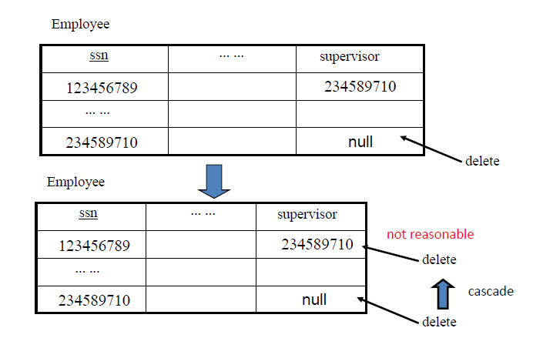
REFERENTIAL INTEGRITY OPTIONS

Slide 12
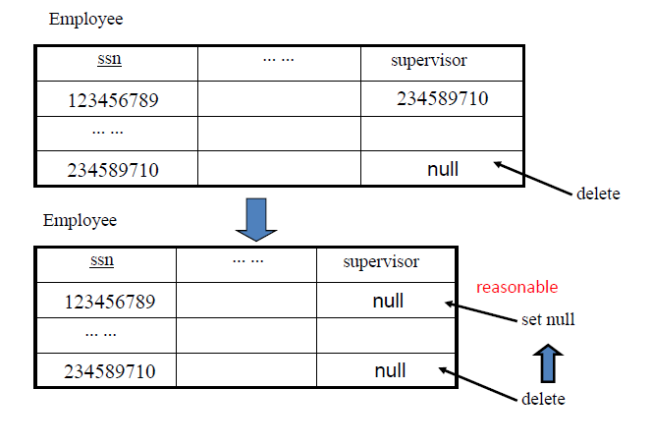
REFERENTIAL INTEGRITY OPTIONS

Slide 13
REFERENTIAL INTEGRITY OPTIONS
CREATE TABLE EMPLOYEE ( ENAME VARCHAR(30) NOT NULL, ESSN CHAR(9), BDATE DATE, DNO INTEGER DEFAULT 1, SUPERSSN CHAR(9), PRIMARY KEY (ESSN), FOREIGN KEY (DNO) REFERENCES DEPARTMENT ON DELETE SET DEFAULT ON UPDATE CASCADE, FOREIGN KEY (SUPERSSN) REFERENCES EMPLOYEE ON DELETE SET NULL ON UPDATE CASCADE
);

Slide 14
SQL CONSTRAINTS
Assigning Names to Constraints
CONSTRAINT deptPK PRIMARY KEY(Dnumber)
CONSTRAINT deptSK UNIQUE(Dname)
CHECK Constraint
CHECK (Dept_create_date <= Mgr_start_date)

Slide 15
DROP COMMAND
Drop Command is used to delete schema or named schema elements such as table, domains, or constraints
Example: DROP TABLE DEPENDENT;
DROP TABLE EMPLOYEE CASCADE;
DROP SCHEMA COMPANY;
In SQL-Server (T-SQL), DROP TABLE cannot be used to drop a table that is referenced by a FOREIGN KEY. The referencing FOREIGN KEY or the referencing table must first be dropped.

Slide 16
ALTER COMMAND
The definition of table or named schema elements can be changed using ALTER command
ALTER can be used to add an attribute to the relation
Initially, the new attribute will have NULLs in all the tuples of the relation
NOT NULL constraint is not allowed for such an attribute
Example : ALTER TABLE EMPLOYEE ADD COLUMN JOB VARCHAR(12); T-SQL syntax
ALTER TABLE EMPLOYEE ADD JOB VARCHAR(12);
The database user have to enter a value for the new attribute JOB for each EMPLOYEE tuple.

Slide 17
ALTER TABLE
ALTER command can be use to add or drop constraints
Example : ALTER TABLE EMPLOYEE add constraint unEmp UNIQUE(NAME) ;
ALTER TABLE EMPLOYEE drop constraint unEmp ;

Slide 18
SQL Queries
Basic form:
SELECT <attributes>
FROM <one or more relations>
WHERE <conditions>
Not same as the SELECT operation of the relational algebra
The result can have duplicate tuples
SQL relation is a multi-set (bag) of tuples; not a set of tuples
Notes:
SQL relations can be constrained to be sets by specifying PRIMARY KEY or UNIQUE attributes, or by using the DISTINCT option in a query

Slide 19
Simple SQL Query
Product
PName | Price | Category | Manufacturer
Gizmo | $19.99 | Gadgets | GizmoWorks
Powergizmo | $29.99 | Gadgets | GizmoWorks
SingleTouch | $149.99 | Photography | Canon
MultiTouch | $203.99 | Household | Hitachi
SELECT * FROM Product WHERE category=‘Gadgets’
PName | Price | Category | Manufacturer
Gizmo | $19.99 | Gadgets | GizmoWorks
Powergizmo | $29.99 | Gadgets | GizmoWorks
“selection”

Slide 20
Simple SQL Query
Product
PName | Price | Category | Manufacturer
Gizmo | $19.99 | Gadgets | GizmoWorks
Powergizmo | $29.99 | Gadgets | GizmoWorks
SingleTouch | $149.99 | Photography | Canon
MultiTouch | $203.99 | Household | Hitachi
SELECT PName, Price, Manufacturer FROM Product WHERE Price > 100
“selection” and
“projection”
PName | Price | Manufacturer
SingleTouch | $149.99 | Canon
MultiTouch | $203.99 | Hitachi

Slide 21
Eliminating Duplicates
Category
Gadgets
Photography
Household
SELECT DISTINCT category
FROM Product
Compare to:
Category
Gadgets
Gadgets
Photography
Household
SELECT category
FROM Product
Notes:
You can use
Select distinct * from Product

Slide 22
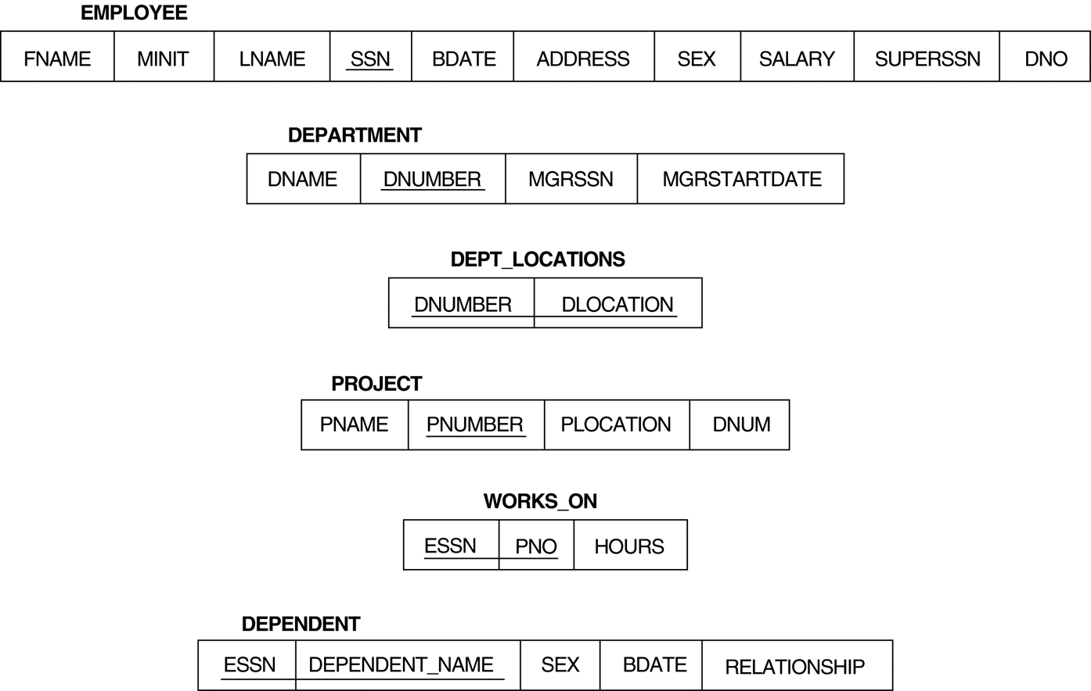
Relational Database Schema

Slide 23
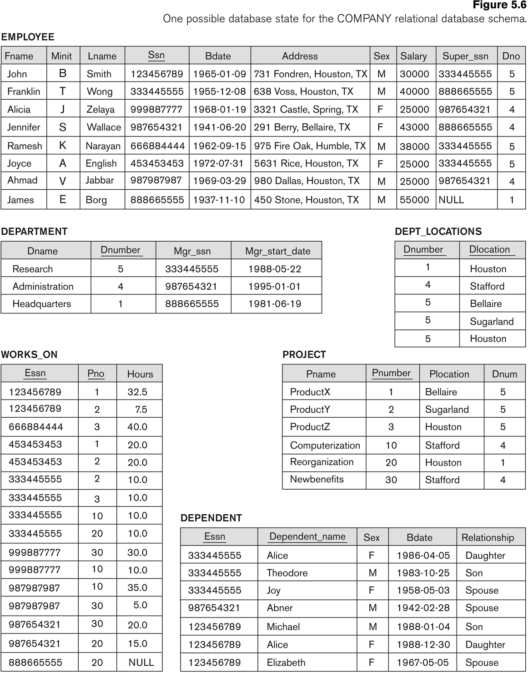
Simple SQL Queries
Basic SQL queries correspond to using the SELECT, PROJECT, and JOIN operations of the relational algebra
Retrieve the birthdate and address of the employee whose name is 'John B. Smith'.
SELECT BDATE, ADDRESS FROM EMPLOYEE WHERE FNAME='John' AND MINIT='B’ AND LNAME='Smith’
Similar to a SELECT-PROJECT pair of relational algebra operations
Notes:
SELECT-clause specifies the projection attributes and the WHERE-clause specifies the selection condition

Slide 24
Join Operation
Retrieve the name and address of all employees who work for the 'Research' department.
SELECT FNAME, LNAME, ADDRESS FROM EMPLOYEE, DEPARTMENT WHERE DNAME='Research' AND DNUMBER=DNO
DNAME='Research’ is a selection condition
DNUMBER=DNO is a join condition

Slide 25
JOIN(cont.)
For every project located in 'Stafford', list the project number, the controlling department number, and the department manager's last name, address, and birthdate.
SELECT PNUMBER, DNUM, LNAME, BDATE, ADDRESS FROM PROJECT, DEPARTMENT, EMPLOYEE WHERE DNUM=DNUMBER AND MGRSSN=SSN AND PLOCATION='Stafford'
Notes:
In above example, there are two join conditions
The join condition DNUM=DNUMBER relates a project to its controlling department
The join condition MGRSSN=SSN relates the controlling department to the employee who manages that department

Slide 26
UNSPECIFIED WHERE-clause
Missing WHERE-clause
indicates there is no condition and is same as WHERE TRUE
Retrieve the SSN values for all employees.
SELECT SSN FROM EMPLOYEE
If there is no join condition, then we get CARTESIAN PRODUCT
SELECT SSN, DNAME FROM EMPLOYEE, DEPARTMENT

Slide 27
USE OF *
To retrieve all the attribute values of the selected tuples, a * is used, which stands for all the attributes Examples:
SELECT * FROM EMPLOYEE WHERE DNO=5 SELECT * FROM EMPLOYEE, DEPARTMENT WHERE DNAME='Research' AND DNO=DNUMBER

Slide 28
Aliases
In SQL, we can use the same name for two (or more) attributes as long as the attributes are in different relations
A query that refers to two attributes with the same name must prefix the relation name to the attribute name
Example:
EMPLOYEE.DNO, DEPARTMENT.DNUMBER

Slide 29
ALIASES
For each employee, retrieve the employee's name, and the name of his or her immediate supervisor.
SELECT E.FNAME, E.LNAME, S.FNAME, S.LNAME FROM EMPLOYEE E S WHERE E.SUPERSSN=S.SSN
Can also use the AS keyword to specify aliases
SELECT E.FNAME, E.LNAME, S.FNAME, S.LNAME FROM EMPLOYEE AS E, EMPLOYEE AS S WHERE E.SUPERSSN=S.SSN
Notes:
The alternate relation names E and S are called aliases or tuple variables for the EMPLOYEE relation
We can think of E and S as two different copies of EMPLOYEE; E represents employees in role of supervisees and S represents employees in role of supervisors

Slide 30
ARITHMETIC OPERATIONS
Arithmetic operators '+', '-'. '*', and '/’) can be applied to numeric values in an SQL query result
Give all employees who work on the 'ProductX' project a 10% raise.
SELECT FNAME, LNAME, 1.1*SALARY FROM EMPLOYEE, WORKS_ON, PROJECT WHERE SSN=ESSN AND PNO=PNUMBER AND PNAME='ProductX’

Slide 31
ORDER BY
The ORDER BY clause sort the tuples in a query result
Retrieve a list of employees and the projects each works in, ordered by the employee's department, and within each department ordered alphabetically by employee last name, then first name.
SELECT DNAME, LNAME, FNAME, PNAME FROM DEPARTMENT, EMPLOYEE, WORKS_ON, PROJECT WHERE DNUMBER=DNO AND SSN=ESSN AND PNO=PNUMBER ORDER BY DNAME, LNAME,FNAME
The default order is in ascending order of values
We can specify the keyword DESC if we want a descending order
ORDER BY Dname DESC, Lname ASC
Notes:
ORDER BY D.Dname DESC, E.Lname ASC, E.Fname ASC

Slide 32
NULLS IN SQL QUERIES
SQL allows queries that check if a value is NULL
SQL uses IS or IS NOT to compare NULLs
Retrieve the names of all employees who do not have supervisors.
SELECT FNAME, LNAME FROM EMPLOYEE WHERE SUPERSSN IS NULL
Note: If a join condition is specified, tuples with NULL values for the join attributes are not included in the result
Notes:
As it considers each NULL value distinct from other NULL values, so equality comparison is not appropriate .

Slide 33
SUBSTRING COMPARISON
LIKE operator is used to compare partial strings
Two reserved characters are used:
'%' (or '*' in some implementations) replaces an arbitrary number of characters, and
'_' replaces a single arbitrary character
Retrieve all employees whose address is in Houston, Texas.
SELECT FNAME, LNAME FROM EMPLOYEE WHERE ADDRESS LIKE '%Houston,TX%’

Slide 34
SUBSTRING COMPARISON (cont.)
Retrieve all employees who were born during the 1950s.
Here, '5' must be the third character of the string , so the BDATE value is ‘__5_______',. SELECT FNAME, LNAME FROM EMPLOYEE WHERE BDATE LIKE ‘__5_______',.
LIKE operator allows us to get around the fact that each value is considered atomic and indivisible;
hence, in SQL, character string attribute values are not atomic

Slide 35
Joined Relations in SQL
Allows the user to specify different types of joins (regular "theta" JOIN, NATURAL JOIN, LEFT OUTER JOIN, RIGHT OUTER JOIN, CROSS JOIN, etc )
Example:
SELECT E.FNAME, E.LNAME, S.FNAME, S.LNAME FROM EMPLOYEE AS E , EMPLOYEE AS S WHERE E.SUPERSSN=S.SSN
SELECT E.FNAME, E.LNAME, S.FNAME, S.LNAME FROM (EMPLOYEE E JOIN EMPLOYEE S ON E.SUPERSSN=S.SSN
SELECT E.FNAME, E.LNAME, S.FNAME, S.LNAME FROM (EMPLOYEE E LEFT OUTER JOIN EMPLOYEE S ON E.SUPERSSN=S.SSN)

Slide 36
Joined Relations Feature in SQL
SELECT FNAME, LNAME, ADDRESS FROM EMPLOYEE, DEPARTMENT WHERE DNAME='Research' AND DNUMBER=DNO
could be written as: SELECT FNAME, LNAME, ADDRESS FROM (EMPLOYEE JOIN DEPARTMENT ON DNUMBER=DNO) WHERE DNAME='Research’ or as: SELECT FNAME, LNAME, ADDRESS FROM (EMPLOYEE NATURAL JOIN DEPARTMENT AS DEPT(DNAME, DNO, MSSN, MSDATE) WHERE DNAME='Research’

Slide 37
Joined Relations Feature in SQL
Example that illustrates multiple joins SELECT PNUMBER, DNUM, LNAME, FROM (PROJECT JOIN DEPARTMENT
ON DNUM=DNUMBER)
JOIN EMPLOYEE ON MGRSSN=SSN) ) WHERE PLOCATION='Stafford’

Slide 38
SET OPERATIONS
SQL has incorporated some set operations like
Union operation (UNION),
Set difference (EXCEPT) and
Intersection operation (INTERSECT)
Duplicate tuples are eliminated from the result
Requires union compatible relations

Slide 39
SET OPERATIONS (cont.)
Make a list of all project numbers for projects that involve an employee whose last name is 'Smith' as a worker or as a manager of the department that controls the project.
(SELECT PNAME FROM PROJECT, DEPARTMENT, EMPLOYEE WHERE DNUM=DNUMBER AND MGRSSN=SSN AND LNAME='Smith') UNION
(SELECT PNAME FROM PROJECT, WORKS_ON, EMPLOYEE WHERE PNUMBER=PNO AND ESSN=SSN AND LNAME='Smith')

Slide 40
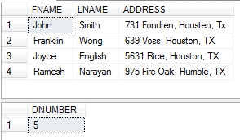
NESTING OF QUERIES
A complete SELECT query, called a nested query , can be specified within the WHERE-clause of another query, called the outer query
Retrieve the name and address of all employees who work for the 'Research' department.
SELECT FNAME, LNAME, ADDRESS FROM EMPLOYEE WHERE DNO IN (SELECT DNUMBER FROM DEPARTMENT WHERE DNAME='Research' )
Notes:
Select fname, lname, address
from Employee,Department
where Dno=Dnumber and Dname='Research‘
The nested query selects the number of the 'Research' department
The outer query select an EMPLOYEE tuple if its DNO value is in the result of nested query
The comparison operator IN compares a value v with a set (or multi-set) of values V, and evaluates to TRUE if v is one of the elements in V

Slide 41
CORRELATED NESTED QUERIES
If a condition in the nested query references an attribute of a relation declared in the outer query , then two queries are said to be correlated
Retrieve the name of each employee who has a dependent with the same first name and gender as the employee.
SELECT E.FNAME, E.LNAME FROM EMPLOYEE AS E WHERE E.SSN IN (SELECT ESSN FROM DEPENDENT AS D WHERE E.SEX = D.SEX AND FNAME=DEPENDENT_NAME)
Nested query is evaluated once for each tuple in outer query
Notes:
select fname
from Employee, Dependent
where fname=dependent_name and ssn=essn
The result of a correlated nested query is different for each tuple (or combination of tuples) of the relation(s) in the outer query

Slide 42
CORRELATED NESTED QUERIES (cont.)
A query written with nested SELECT... FROM... WHERE... blocks and using the = or IN comparison operators can always be expressed as a single block query.
For example, the query on previous slide can be written as
Retrieve the name of each employee who has a dependent with the same first name as the employee.
SELECT E.FNAME, E.LNAME FROM EMPLOYEE E, DEPENDENT D WHERE E.SSN=D.ESSN AND E.FNAME=D.DEPENDENT_NAME
Notes:
A DML statement that includes a subquery is referred to as the outer query. The following guidelines provide details about how to implement subqueries in your outer queries or in other subqueries:
You must enclose a subquery in parenthesis.
A subquery must include a SELECT clause and a FROM clause.
A subquery can include optional WHERE, GROUP BY, and HAVING clauses.
A subquery cannot include COMPUTE or FOR BROWSE clauses.
You can include an ORDER BY clause only when a TOP clause is included.
You can nest subqueries up to 32 levels.

Slide 43
Nested queries
SQL allows use of tuples of values in comparisons
Select the Essns of all employees who work the same (project, hours) combination that ‘John Smith’ (whose Ssn = ‘123456789’) works on.
SELECT DISTINCT Essn
FROM WORKS_ON
WHERE (Pno, Hours) IN ( SELECT Pno, Hours
FROM WORKS_ON
WHERE Essn=‘123456789’ );
Notes:
A subquery can be written in FROM clause. However, using subquery in FROM clause should generally be avoided if you can rewrite your query in a different way, the reason being that no indexes can be used on a temporary table in memory. Also, A subquery in the FROM clause can't be correlated subquery as it can't be evaluated per row of the outer query.

Slide 44
EXISTS FUNCTION
EXISTS Function checks whether the result of a nested query is empty or not
Retrieve the name of each employee who has a dependent with the same first name as the employee.
SELECT FNAME, LNAME FROM EMPLOYEE WHERE EXISTS (SELECT * FROM DEPENDENT WHERE SSN=ESSN AND FNAME=DEPENDENT_NAME)

Slide 45
EXISTS FUNCTION (cont.)
Retrieve the names of employees who have no dependents.
SELECT FNAME, LNAME FROM EMPLOYEE WHERE NOT EXISTS (SELECT * FROM DEPENDENT WHERE SSN=ESSN)
The above correlated nested query retrieves all DEPENDENT tuples related to an EMPLOYEE tuple.
If none exist , the EMPLOYEE tuple is selected
EXISTS is necessary for the expressive power of SQL

Slide 46
EXISTS FUNCTION (cont.)
Find the names of managers who have at least one dependents.
SELECT FNAME, LNAME FROM EMPLOYEE WHERE EXISTS (SELECT * FROM DEPENDENT WHERE SSN=ESSN)
AND
EXISTS (SELECT * FROM DEPARTMENT WHERE SSN=Mgr_SSN)

Slide 47
EXISTS FUNCTION (cont.)
Retrieve the name of each employee who works on all the projects controlled by department number 5.
Set theory: S1 contains S2 if (S2 – S1 = 0)
SELECT FNAME, LNAME FROM EMPLOYEE WHERE NOT EXISTS (
(SELECT PNUMBER FROM PROJECT WHERE DNUM=5) EXCEPT (SELECT PNO FROM WORKS_ON WHERE SSN=ESSN) )
S1 = set of projects of each employee
S2= set of DN0=5 projects

Slide 48
NESTED QUERIES
CONTAINS compares two sets , and returns TRUE if one set contains all values in the other set.
Same as division operation of relational algebra
Retrieve the name of each employee who works on all the projects controlled by department number 5.
SELECT FNAME, LNAME FROM EMPLOYEE WHERE ( (SELECT PNO FROM WORKS_ON WHERE SSN=ESSN) CONTAINS (SELECT PNUMBER FROM PROJECT WHERE DNUM=5) )
Most implementations of SQL do not have this operator

Slide 49
NESTED CORRELATED QUERIES (contd)
You can also use: s > ALL R
s > ANY R
EXISTS R
Product ( pname, price, category, maker)
Find products that are more expensive than all those produced
By “IBM”
SELECT name
FROM Product
WHERE price > ALL (SELECT price
FROM Purchase
WHERE maker=‘IBM’)

Slide 50

NESTED CORRELATED QUERIES (contd)
You can also use: s > ALL R
s > ANY R
EXISTS R
Find Employee whose salary is greater than the salary
of all employee in department 5
SELECT Fname
FROM Employee
WHERE Salary > ALL (SELECT Salary
FROM Employee
where Dno=5)

Slide 51
Complex Correlated Query
Product ( pname, price, category, maker, year)
Find products (and their manufacturers) that are more expensive than all products made by the same manufacturer before 1972
Very powerful ! Also much harder to optimize.
SELECT DISTINCT pname, maker
FROM Product AS x
WHERE price > ALL (SELECT price
FROM Product AS y
WHERE x.maker = y.maker AND x.pname!=y.pname and
y.year < 1972)

Slide 52
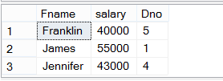
Complex Correlated Query
Find Employee (his dno and salary) whose salary is greater than all employees in the same department
SELECT Fname, Salary, Dno
FROM Employee as E
WHERE Salary > ALL (SELECT Salary
FROM Employee as S
WHERE E.dno=S.dno and E.ssn !=S.ssn )

Slide 53
EXPLICIT SETS
It is also possible to use an explicit (enumerated) set of values in the WHERE-clause rather than a nested query
Retrieve the social security numbers of all employees who work on project number 1, 2, or 3.
SELECT DISTINCT ESSN FROM WORKS_ON WHERE PNO IN (1, 2, 3)

Slide 54
AGGREGATE FUNCTIONS
Include COUNT, SUM, MAX, MIN, and AVG
Find the maximum salary, the minimum salary, and the average salary among all employees. SELECT MAX(SALARY), MIN(SALARY), AVG(SALARY) FROM EMPLOYEE
Some SQL implementations may not allow more than one function in the SELECT-clause

Slide 55
AGGREGATE FUNCTIONS (cont.)
Retrieve the number of employees in the 'Research' department SELECT COUNT (*) FROM EMPLOYEE, DEPARTMENT WHERE DNO=DNUMBER AND DNAME='Research’

Slide 56
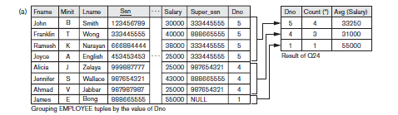
GROUPING
GROUP BY-clause specifies the grouping attributes
For each department, retrieve the department number, the number of employees in the department, and their average salary.
SELECT DNO, COUNT (*), AVG (SALARY) FROM EMPLOYEE GROUP BY DNO
Notes:
Each subgroup of tuples consists of the set of tuples that have the same value for the grouping attribute(s)
Cannot include employee name in the select because not contained in group by

Slide 57
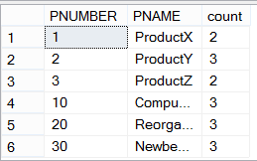
GROUPING (cont.)
For each project, retrieve the project number, project name, and the number of employees who work on that project.
SELECT PNUMBER, PNAME, COUNT (*) FROM PROJECT, WORKS_ON WHERE PNUMBER=PNO GROUP BY PNUMBER, PNAME
The grouping and functions are applied after the joining of the two relations
Group By clause specifies grouping attributes which should appear in SELECT clause

Slide 58
HAVING-CLAUSE
HAVING-clause specify a selection condition on groups
For each project on which more than two employees work , retrieve the project number, project name, and the number of employees who work on that project.
SELECT PNUMBER, PNAME, COUNT (*) FROM PROJECT, WORKS_ON WHERE PNUMBER=PNO GROUP BY PNUMBER, PNAME HAVING COUNT (*) > 2

Slide 59
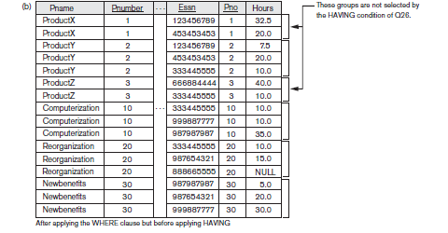
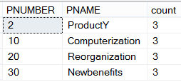
HAVING-CLAUSE

Slide 60
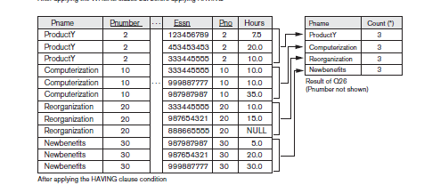
HAVING-CLAUSE

Slide 61
Group By and Having
Count the total number of employees whose salaries exceed $40,000 in each department, but only for departments where more than five employees work
SELECT Dname, COUNT (*)
FROM DEPARTMENT, EMPLOYEE
WHERE Dnumber=Dno AND Salary>40000
GROUP BY Dname
HAVING COUNT (*) > 5;

Slide 62
General form of Grouping and Aggregation
SELECT S
FROM R₁,…,R_{n}
WHERE C1
GROUP BY a₁,…,a_{k}
HAVING C2
Evaluation steps:
Evaluate FROM-WHERE, apply condition C1
Group by the attributes a₁,…,a_{k}
Apply condition C2 to each group (may have aggregates)
Compute aggregates in S and return the result

Slide 63
Two Examples
Store(sid, sname)
Product(pid, pname, price, sid)
Find stores that sell only products with price > 100
same as:
Find stores s.t. all their products have price > 100)

Slide 64
SELECT Store.name
FROM Store, Product
WHERE Store.sid = Product.sid
GROUP BY Store.sid, Store.name
HAVING 100 < min(Product.price)
Find stores s.t. all their products have price > 100
SELECT Store.name
FROM Store
WHERE 100 < ALL (SELECT Product.price FROM product WHERE Store.sid = Product.sid)
Almost equivalent…
SELECT Store.name
FROM Store
WHERE Store.sid NOT IN
(SELECT Product.sid
FROM Product
WHERE Product.price <= 100)

Slide 65
Aggregate Example
Example: Count the number of distinct salary values in the database.
SELECT COUNT (DISTINCT Salary)
FROM EMPLOYEE;
NULL values are discarded when aggregate functions are applied to a particular attribute.
Notes:
If we write COUNT(SALARY) instead of COUNT(DISTINCT SALARY) in Q23, then
duplicate values will not be eliminated. However, any tuples with NULL for SALARY
will not be counted. In general, NULL values are discarded when aggregate functions
are applied to a particular column (attribute).

Slide 66
Summary of SQL Queries
A query in SQL can consist of up to six clauses, but only the first two, SELECT and FROM, are mandatory. The clauses are specified in the following order: SELECT <attribute list> FROM <table list> [WHERE <condition>] [GROUP BY <grouping attribute(s)>] [HAVING <group condition>] [ORDER BY <attribute list>]
A query is evaluated by first applying the WHERE-clause, then GROUP BY and HAVING, and finally the SELECT-clause

Slide 67
Summary of SQL Queries (cont.)
The SELECT-clause lists the attributes or functions to be retrieved
The FROM-clause specifies all relations (or aliases) needed in the query but not those needed in nested queries
The WHERE-clause specifies the conditions for selection and join of tuples from the relations specified in the FROM-clause
GROUP BY specifies grouping attributes
HAVING specifies a condition for selection of groups
ORDER BY specifies an order for displaying the result of a query

Slide 68
SQL Queries
There are various ways to specify the same query in SQL
This is to give flexibility to user to specify queries
For query optimization, it is preferable to write a query with as little nesting and implied ordering as possible.
Ideally, DBMS should process the same query in the same way regardless of how the query is specified.
But this is quite difficult in practice, (chapter 19,20)

Slide 69
Specifying Updates in SQL
There are three SQL commands to modify the database;
INSERT,
DELETE, and
UPDATE

Slide 70
INSERT
It is used to add one or more tuples to a relation
Example: INSERT INTO EMPLOYEE VALUES ('Richard','K','Marini', '653298653', '30-DEC-52', '98 Oak Forest,Katy,TX', 'M', 37000,'987654321', 4 )
Attribute values should be listed in the same order as the attributes were specified in the CREATE TABLE command

Slide 71
INSERT (cont.)
An alternate form of INSERT specifies explicitly the attribute names that correspond to the values in the new tuple
Example: Insert a tuple for a new EMPLOYEE for whom we only know the FNAME, LNAME, and SSN attributes. INSERT INTO EMPLOYEE (FNAME, LNAME, SSN) VALUES ('Richard', 'Marini', '653298653')
Attributes with NULL values can be left out

Slide 72
INSERT (cont.)
Suppose we want to create a temporary table that has the name, number of employees, and total salaries for each department.
A table DEPTS_INFO is created by Q1, and is loaded with the information retrieved from the database by the query Q2. Q1: CREATE TABLE DEPTS_INFO (DEPT_NAME VARCHAR(10), NO_OF_EMPS INTEGER, TOTAL_SAL INTEGER); Q2: INSERT INTO DEPTS_INFO (DEPT_NAME, NO_OF_EMPS, TOTAL_SAL) SELECT DNAME, COUNT (*), SUM (SALARY) FROM DEPARTMENT, EMPLOYEE WHERE DNUMBER=DNO GROUP BY DNAME ;
Notes:
Note: The DEPTS_INFO table may not be up-to-date if we change the tuples in either the DEPARTMENT or the EMPLOYEE relations after issuing U3B. We have to create a view (see later) to keep such a table up to date.

Slide 73
DELETE
Removes tuples from a relation
Tuples are deleted from only one table at a time (unless CASCADE is specified on a referential integrity constraint)
Examples: DELETE FROM EMPLOYEE WHERE LNAME='Brown’ DELETE FROM EMPLOYEE WHERE DNO IN (SELECT DNUMBER FROM DEPARTMENT WHERE DNAME='Research')
DELETE FROM EMPLOYEE
Notes:
A missing WHERE-clause specifies that all tuples in the relation are to be deleted; the table then becomes an empty table
Includes a WHERE-clause to select the tuples to be deleted

Slide 74
UPDATE
Used to modify attribute values of selected tuples
Example: Change the location and controlling department number of project number 10 to 'Bellaire' and 5, respectively. UPDATE PROJECT SET PLOCATION = 'Bellaire', DNUM = 5 WHERE PNUMBER=10
Notes:
A WHERE-clause selects the tuples to be modified
An additional SET-clause specifies the attributes to be modified and their new values
Each command modifies tuples in the same relation
Referential integrity should be enforced

Slide 75
UPDATE (cont.)
Example: Give all employees in the 'Research' department a 10% raise in salary. UPDATE EMPLOYEE SET SALARY = SALARY *1.1 WHERE DNO IN (SELECT DNUMBER FROM DEPARTMENT WHERE DNAME='Research')
Notes:
In this request, the modified SALARY value depends on the original SALARY value in each tuple
The reference to the SALARY attribute on the right of = refers to the old SALARY value before modification
The reference to the SALARY attribute on the left of = refers to the new SALARY value after modificatio

Slide 76
Views in SQL
A view is a “virtual” table that is derived from other tables
Allows for limited update operations (since the table may not physically be stored)
Allows full query operations
A convenience for expressing certain operations
They are used to:
simplify complex queries, and
define distinct conceptual interfaces for different users.

Slide 77

SQL Views: An Example
Specify a different WORKS_ON table
CREATE VIEW WORKS_ON1 AS
SELECT FNAME, LNAME, PNAME, HOURS
FROM EMPLOYEE, PROJECT, WORKS_ON
WHERE SSN=ESSN AND PNO=PNUMBER

Slide 78
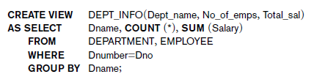

SQL Views: An Example2

Slide 79
Using a Virtual Table
We can specify SQL queries on a newly created view:
SELECT FNAME, LNAME
FROM WORKS_ON1
WHERE PNAME=‘ProductX’;
DBMS is responsible to keep view always up-to-date
When no longer needed, a view can be dropped:
DROP WORKS_ON1;

Slide 80

Efficient View Implementation
Query modification: present the view query in terms of a query on the underlying base tables
SELECT FNAME, LNAME, PNAME, HOURS
FROM EMPLOYEE, PROJECT, WORKS_ON
WHERE SSN=ESSN AND PNO=PNUMBER AND PNAME=‘PRODUCTX’
Disadvantage:
Inefficient for views defined via complex queries (esp if additional queries are to be applied within a short time period )

Slide 81
Efficient View Implementation
View materialization: involves physically creating and keeping a temporary table
assumption: other queries on the view will follow
concerns: maintaining correspondence between the base table and the view when the base table is updated
strategy: incremental update

Slide 82
View Update
Single view without aggregate operations:
update may map to an update on the underlying base table
Views involving joins:
an update may map to an update on the underlying base relations
not always possible
Example:
update works_on1
set pname=XYZ'
where Fname=‘John and
lname='Smith' AND Pname=‘ProductX’

Slide 83
a) Update works_on1
Set pno = (select Pnumber from project
where pname=‘XYZ’)
Where Essn IN (select ssn from employee
where lname=‘smith’ and fname=‘John’)
AND
Pno = (Select pnumber from project
where pname=‘ProductX’)
b)Update Project set pname=‘XYZ’
where pname=‘productX’

Slide 84

Un-updatable Views
Views defined using groups and aggregate functions are not updateable
Views defined on multiple tables using joins are generally not updateable
WITH CHECK OPTION: must be added to the definition of a view if the view is to be updated
to allow check for updatability and to plan for an execution strategy

Slide 85
Assertion
In SQL, table constraints are associated with a single table.
CHECK(DNUMBER >0 AND DNUMBER <25)
CHECK (Dept_create_date <= Mgr_start_date)
Expression in the CHECK clause can refer to other tables but when a constraint involves many tables, it becomes cumbersome
Assertions are constraints that are not associated with any one table.
SQL-server do not support assertion, however it do support trigger and check constraint
Notes:
although the conditional expression in the CHECK clause can refer to other tables. Table constraints are required to hold only if the associated table is nonempty. Thus, when a constraint involves two or more tables, the table constraint mechanism is sometimes cumbersome and not quite what is desired.

Slide 86
Assertions: An Example
“The salary of an employee must not be greater than the salary of the manager of the department that the employee works for’’
CREATE ASSERTION SALARY_CONSTRAINT
CHECK (NOT EXISTS (SELECT *
FROM EMPLOYEE E, EMPLOYEE M, DEPARTMENT D
WHERE E.SALARY > M.SALARY AND
E.DNO=D.NUMBER AND D.MGRSSN=M.SSN))

Slide 87
Using General Assertions
Specify a query that violates the condition; include inside a NOT EXISTS clause
Query result must be empty
if the query result is not empty, the assertion has been violated
Create Assertion to enforce the constraint that
The number of Employees in each department should be less than 20.
An employee should be assign a project of his\her department only.
The total working hours of all the employees in a department should be less than 180.
Notes:
CREATE ASSERTION DEPT_EMPs
CHECK( Not Exists (SELECT Dno
FROM Employee
Group By Dno
Having count(ssn) > 100))
*** Use table constarints in sql –server*****
ALTER TABLE Employee
ADD CONSTRAINT no_of_emp
CHECK( Not Exists (SELECT Dno
FROM Employee
Group By Dno
Having count(ssn) > 100))

Slide 88
CHECK clause can also be used to specify constraints on individual attributes, domains and individual tuples
CONSTRAINT deptPK PRIMARY KEY(Dnumber)
CONSTRAINT deptSK UNIQUE(Dname)
CHECK (Dept_create_date <= Mgr_start_date)
Difference between CREATE ASSERTION and the individual domain and tuple constraints is
CHECK on individual attributes, domains, and tuples are checked only when tuples are inserted or updated.

Slide 89
SQL Triggers
Objective: to monitor a database and take action when a condition occurs
Triggers are expressed in a syntax similar to assertions and include the following:
event (e.g., an update operation)
condition
action (to be taken when the condition is satisfied)
Notes:
A manager may
want to be informed if an employee’s travel expenses exceed a certain limit by
receiving a message whenever this occurs. The action that the DBMS must take in
this case is to send an appropriate message to that user.

Slide 90
SQL Triggers: An Example
A trigger to compare an employee’s salary to his/her supervisor during insert or update operations:
CREATE TRIGGER INFORM_SUPERVISOR
BEFORE INSERT OR UPDATE OF
SALARY, SUPERVISOR_SSN ON EMPLOYEE
FOR EACH ROW
WHEN
(NEW.SALARY> (SELECT SALARY FROM EMPLOYEE
WHERE SSN=NEW.SUPERVISOR_SSN))
INFORM_SUPERVISOR (NEW.SUPERVISOR_SSN,NEW.SSN;
Notes:
For assertion on multiple table create triggers as sql server do not provide create assertion
CREATE TRIGGER trg ON tbl
Before INSERT, UPDATE AS ... IF EXISTS( SELECT * FROM ...) ROLLBACK

Slide 91
Example: Boat Rental database
Consider the following Boat Rental database schema
SAILOR (SID, SName, Phone, City)
BOAT (BName, BType, Price, OID)
RESERVATION (SID, BName, Date, Duration)
OWNER (OID, OName, Phone, Street, City, Country)
Find the name and city of sailors who reserve every ‘Fishing’ boat.
Find the names of boats that are reserved by at least ten different sailors.
List names, owner names, and prices of the boats which were reserved in 2007 but not in 2008.

Slide 92
Example: Boat Rental database
Consider the following schema
SAILOR (SID, SName, Phone, City)
BOAT (BName, BType, Price, OID)
RESERVATION (SID, BName, Date, Duration)
OWNER (OID, OName, Phone, Street, City, Country)
Find the name and city of sailors who reserve every ‘Fishing’ boat.
SELECT SNAME, CITY FROM SAILOR s WHERE NOT EXISTS ( (SELECT BNAME
FROM BOAT WHERE BTYPE=’Fishing’) EXCEPT (SELECT BNAME FROM reservation r
WHERE r.SID=s.SID) )

Slide 93
Example: Boat Rental database
Consider the following schema
SAILOR (SID, SName, Phone, City)
BOAT (BName, BType, Price, OID)
RESERVATION (SID, BName, Date, Duration)
OWNER (OID, OName, Phone, Street, City, Country)
Find the names of boats that are reserved by at least ten different sailors.
Select bname
From reservation r
Group by bname
Having count(DISTINCT SID) >9

Slide 94
Example: Boat Rental database
Consider the following schema
SAILOR (SID, SName, Phone, City)
BOAT (BName, BType, Price, OID)
RESERVATION (SID, BName, Date, Duration)
OWNER (OID, OName, Phone, Street, City, Country)
List names, owner names, and prices of the boats which were reserved in 2007 but not in 2008.
Select distinct b.bname, b.price, o.oname
From reservation r, boat b, owner o
Where r.bname = b.bname and b.oid=o.oid and r.date LIKE '%2007%' and r.sid not in
(Select ic.sid
From reservation ic, boat ip
Where ic.bname = ip.bname and ip.date LIKE '%2008%' )

Slide 95
Example: Boat Rental database
Consider the following Boat Rental database schema:
SAILOR (SID, SName, Phone, City)
BOAT (BName, BType, Price, OID)
RESERVATION (SID, BName, Date, Duration)
OWNER (OID, OName, Phone, Street, City, Country)
SELECT DISTINCT Bname
FROM BOAT
WHERE Price > ALL (SELECT price
FROM BOAT b , OWNER o
WHERE b.oid=o.oid and Country=‘Pakistan’ )
What does the query do?
Notes:
List the names of the most boats that are expensive then all boats owned by a Pakistani

Slide 96
Example: Boat Rental database
Consider the following Boat Rental database schema:
SAILOR (SID, SName, Phone, City)
BOAT (BName, BType, Price, OID)
RESERVATION (SID, BName, Date, Duration)
OWNER (OID, OName, Phone, Street, City, Country)
Select bname,count(*)
From reservation r ,boat b,owner o
Where b.bname=r.bname and b. oid=o.oid and country=‘Pakistan’
Group by bname
Having count(*) > 5
What does the query do?
Notes:
List the names of the boats that are owned by a Pakistani and were reserved by at least five sailors.

